Slide 1

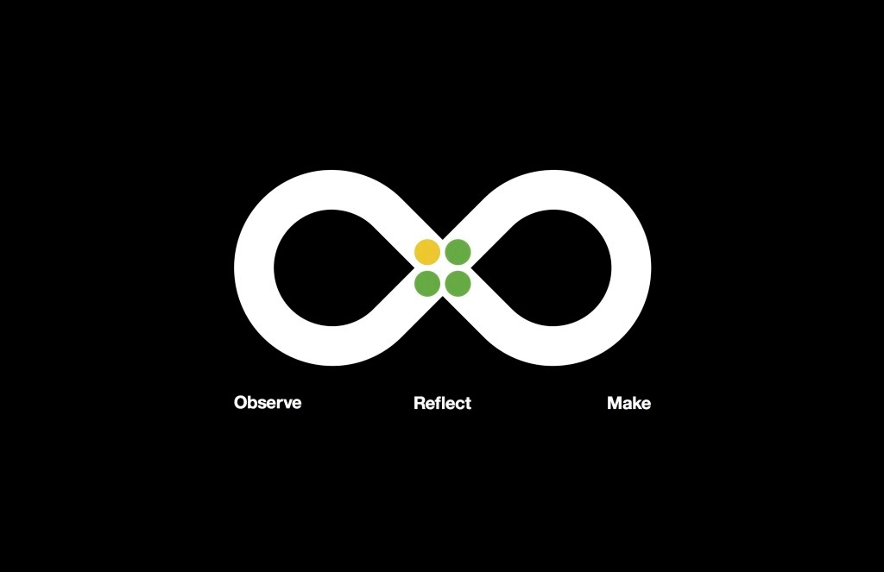
IBM Design Thinking Instructor: Prof. Vishal Chawla
College of Engineering

Slide 2

Design is the intent behind an outcome. It is not a product designers produce, but it is a process that designers facilitate
What is DESIGN

Slide 3
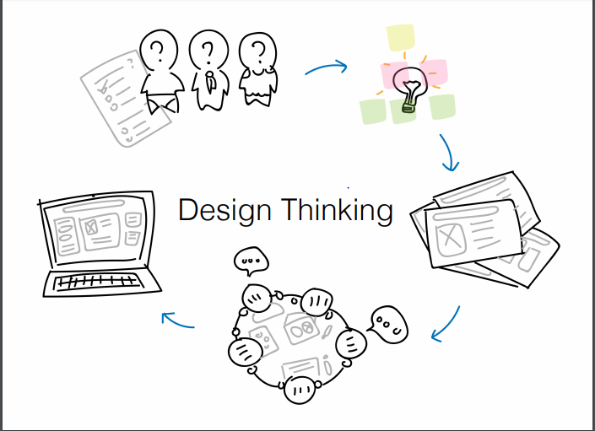
What is Design thinking?
Designers don't try to search for a solution until they have determined the real problem, and even then, instead of solving that problem, they stop to consider a wide range of potential solutions. Only then will they finally converge upon their proposal. This process is called ‘design thinking.’

Slide 4

IBM Design Thinking
It is a hands-on framework that helps you craft great business outcomes at the speed and scale of enterprise

Slide 5
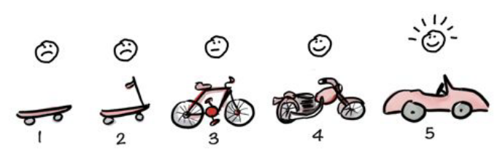
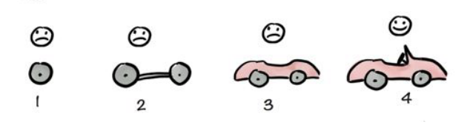
Traditional product development
User-centric product development
Focused on incremental delivery of functionality
Incremental delivery of value to the user

Slide 6
Design thinking is for everybody
PRODUCT MANAGERS
DEVELOPERS
TESTORS
ARCHITECTS
DOCUMENTATION FOLKS
STUDENTS
TEACHERS
…

Slide 7
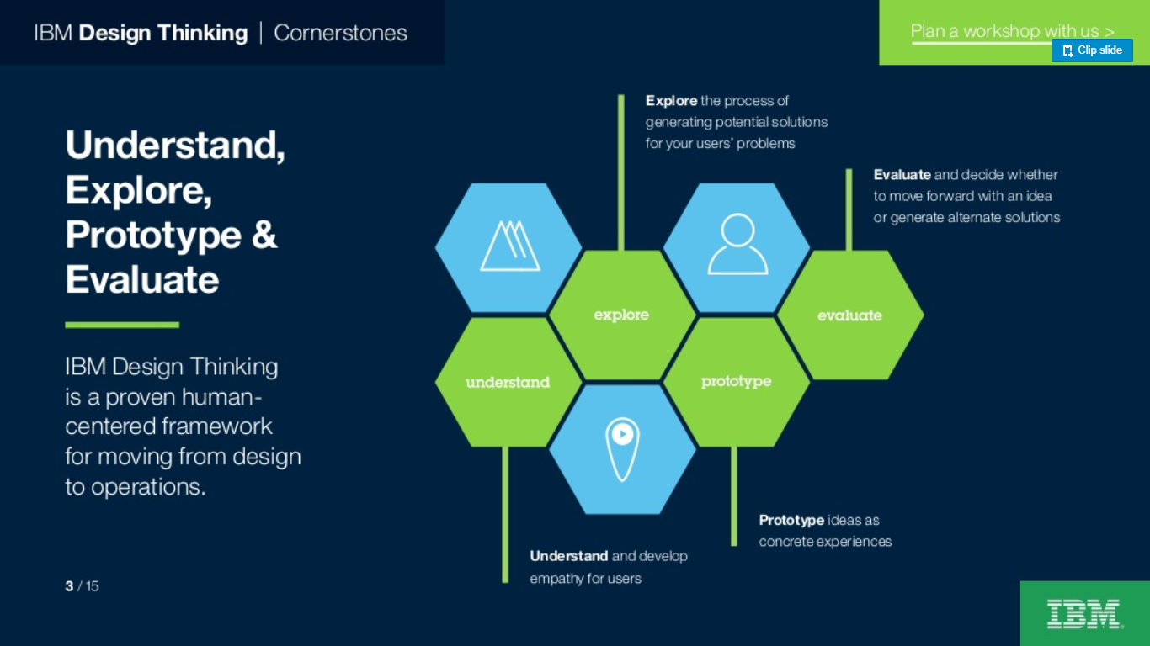
Applying IBM Design Thinking

Slide 8
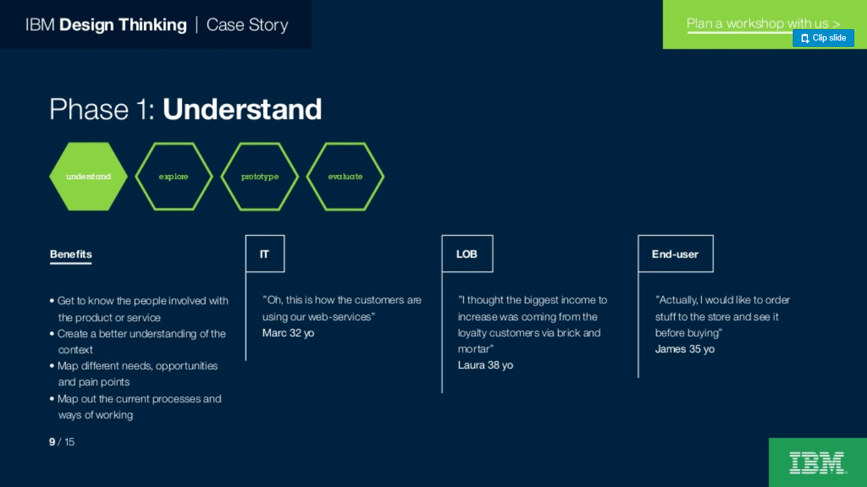
Phase 1: Understand
Benefits:
Get to know the people involved with the product
Create better understanding of the context
Map different needs, opportunities and points
Map out current processes and ways of working

Slide 9
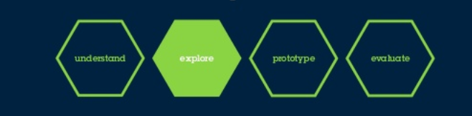
Phase 2: Explore
Benefits:
Create shared goals together and compare gains and costs
Create alternative ideas and design concepts
Select few ideas that best fits
Evaluate to-be scenarios based on the refined ideas

Slide 10
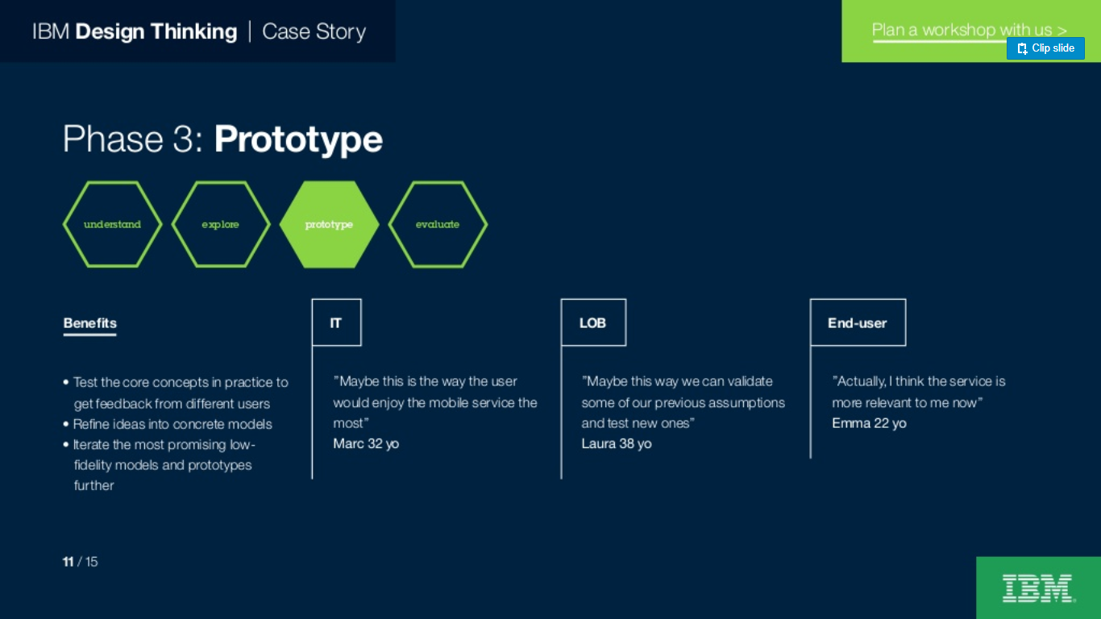
Phase 3: Prototype
Benefits:
Test the core concepts in practice to get feedback
Refine ideas into concrete models
Iterate the most promising low-fidelity models and prototypes further

Slide 11
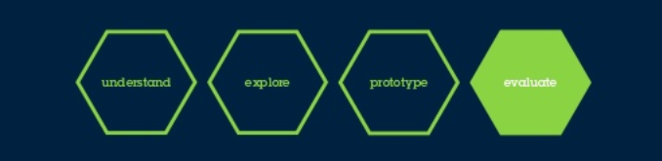
Phase 4: Evaluate
Benefits:
Evaluate what has been done so far
Decide if there is a need to go back to previous steps
Based on evaluation, the development work continues in the right direction

Slide 12
Major outcomes of Design Thinking
Refine Strategy
Minimize risk
Reduce cost
Design better solution
Delight customers

Slide 13
IBM Design Thinking
“A proven way to come to better solutions, faster. “
HOW??
Understand people’s needs
Deliver outcomes at speed and scale

Slide 14
GROUND RULES:
Write before you talk
There are no bad ideas
Stay focused on your users
Everyone participates
Stay engaged
Start on time , stay on time

Slide 15
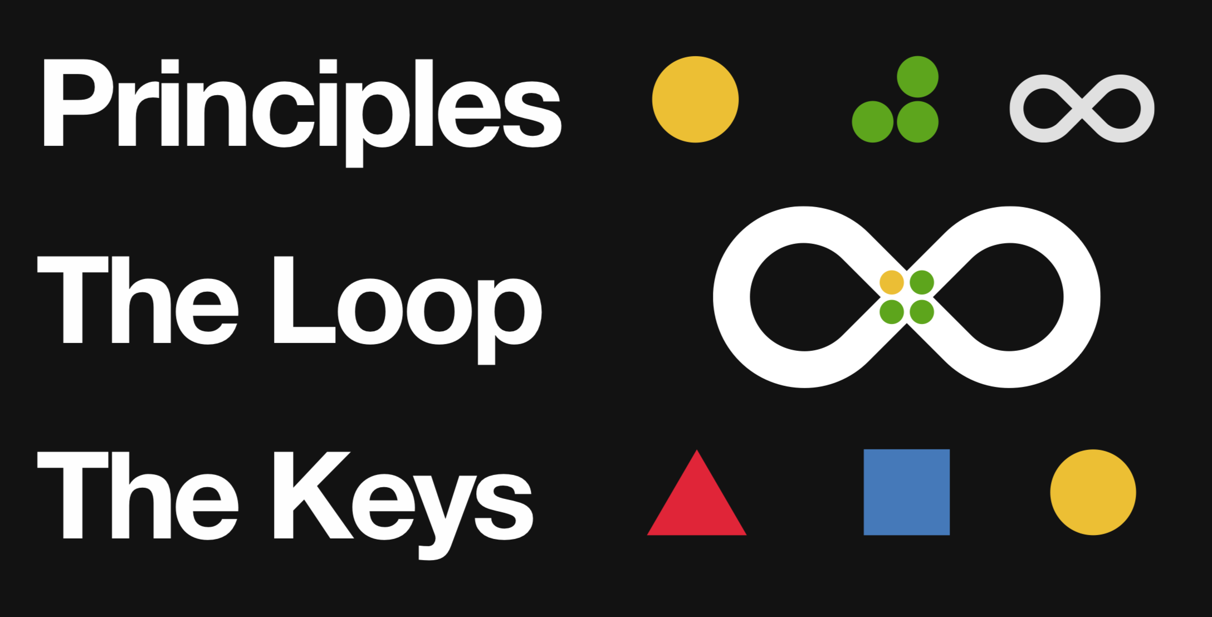
The Framework

Slide 16

Focus on user outcomes
Multi-disciplinary teams
Restless reinvention

Slide 17
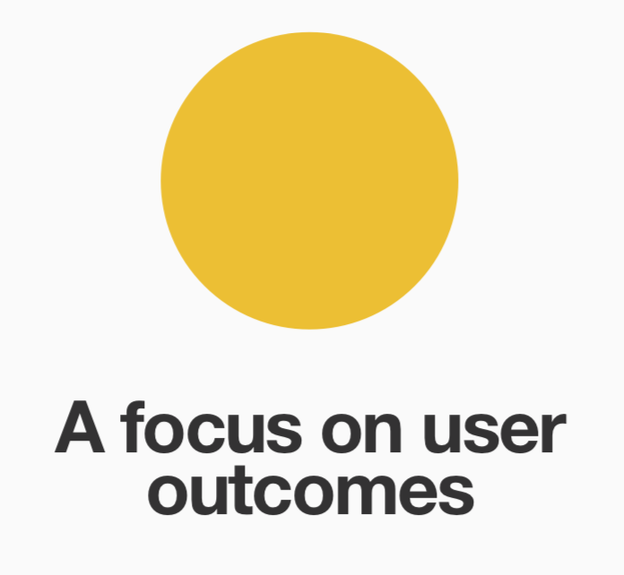
Make users your North Star
Help users achieve their goals
Users needs fulfillment is given preference

Slide 18

Move faster and work smarter by collaborating as a unit, and not as an individual
Diverse teams generate more ideas
Build foundation of mutual trust and respect

Slide 19
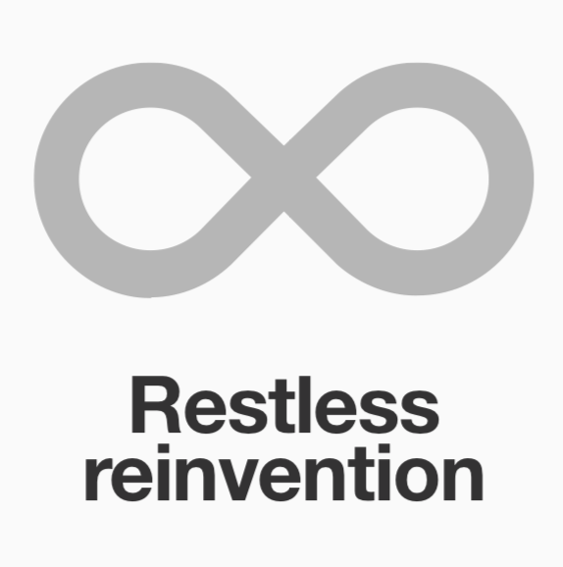
Everything is a prototype
Conversation between users and team
Loop of continuous understanding

Slide 20

“Understand the present and envision the future in a continuous cycle of observing, reflecting, and making “

Slide 21
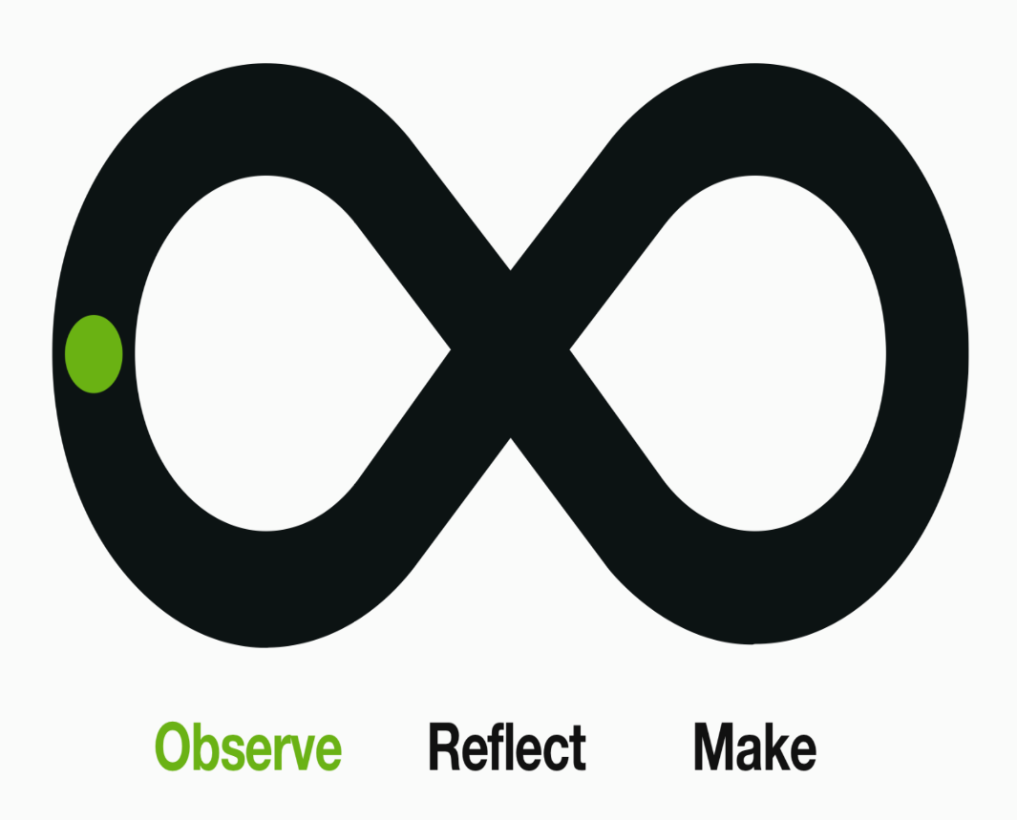
Get to know users
Uncover needs
Listen for feedback
REMEMBER:
This isn’t about selling ideas or seeking approval. It’s about discovering new opportunities to improve your project’s outcome

Slide 22
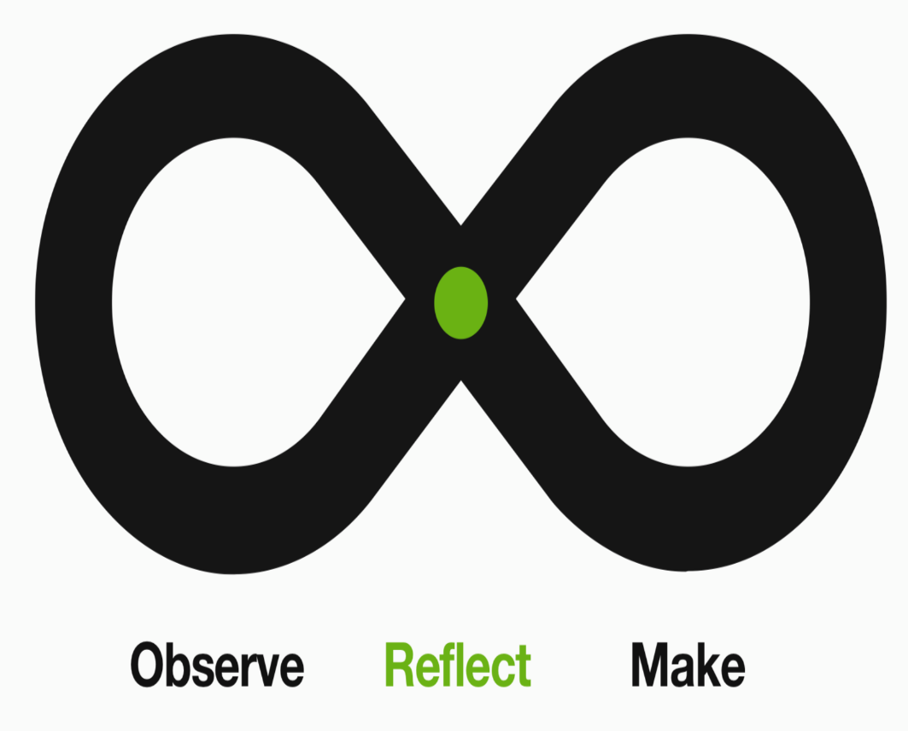
Get to know each other
Align on intent
Uncover new insights
Plan ahead

Slide 23
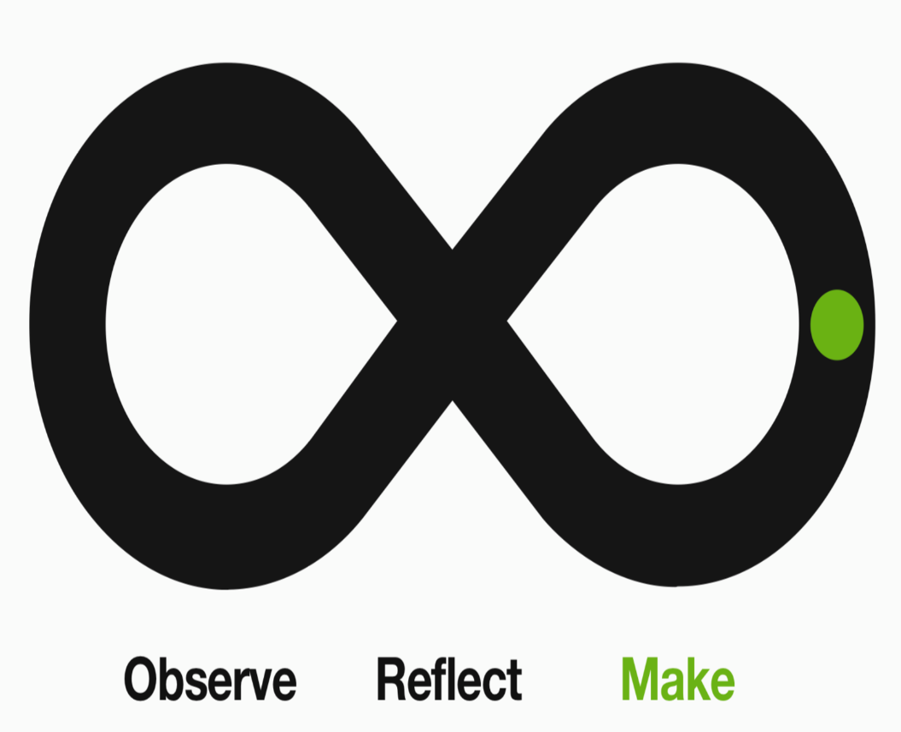
Explore possibilities
Communicate ideas
Prototype concepts
Drive outcomes

Slide 24

Hills
Playbacks
Sponsor Users

Slide 25
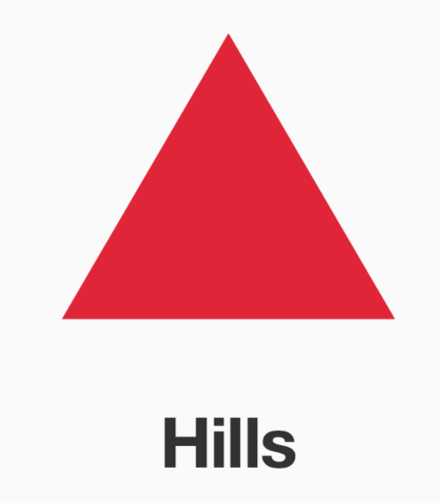
Hills define the mission and scope of a release and serve to focus the design and development work on desired, measurable outcomes
Aligns us across teams. Helps set objectives for each team
Tells us where to go, not how to go there

Slide 26

Get everyone in the loop
Aligns us across time as we are iterating and evolving in understanding the solution
We tell a story from the perspective of an end user based on what we observed, reflected and made

Slide 27

Aligns us with user reality
Users who bring their lived experience and domain expertise to the team
Helps observe, reflect and make and tightens the loop

Slide 28
Conclusion
Brings up-front analysis and user feedback in all the iterations
Offers better understanding of what problems need to be solved and best solutions to satisfy user needs
End users have very high satisfaction rate on the projects delivered

Slide 29

Thank you!
College of Engineering

Slide 30
Class Exercise
Take any example of websites like Sears, Target, Walmart or JCPenny
How can design thinking makes these sites more innovative and competitive as these are facing lots of competition from Amazon?

